Slide 1

MITRON BANK
Credit
Card Analysis

Slide 2
Available Data
Missing Data
Mitron Bank has provided sample data of 4000 customers spread across 5 cities – Bengaluru, Chennai, Delhi NCR, Hyderabad and Mumbai and their transactions over 6 months from May to September. Customers demographic details are provided in dim_customers csv file. And their spending/transaction details are provided in fact_spends csv file. For each customer in dim_customers file, there are 6 rows of data in fact_spends file – one for each transaction per month.
Credit Limit for every income level is missing.
Only Month value and no day, year information is available.
Card Type Information like Visa, Platinum, Gold, Silver etc is missing.
Dim Customers
Customer ID
Age group
City
Occupation
Gender
Marital Status
Average Income
Fact Spends
Customer ID
Month
Category
Occupation
Payment Type
Spend

Slide 3

Demographics

Slide 4
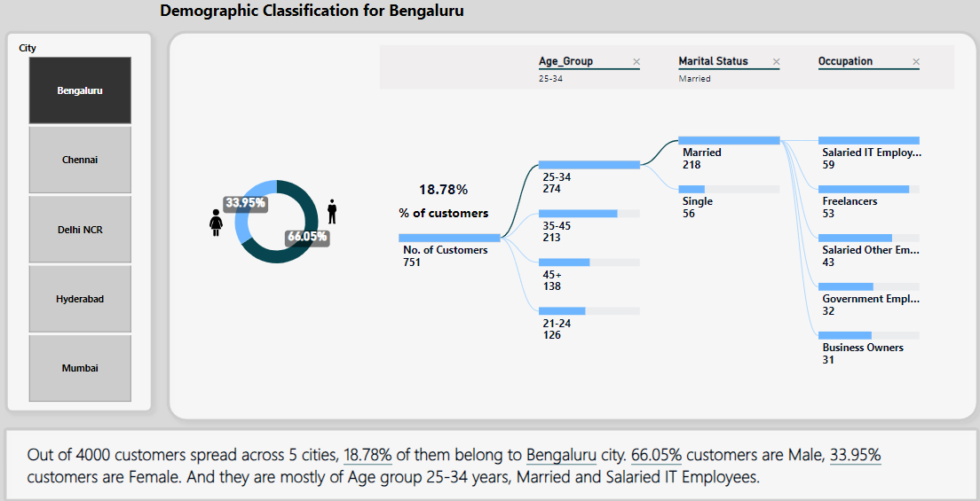
Demographics..

Slide 5
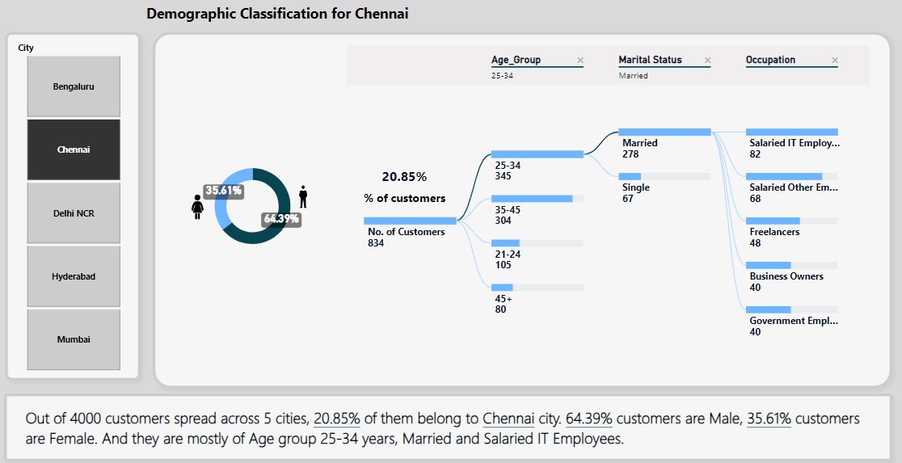
Demographics..

Slide 6
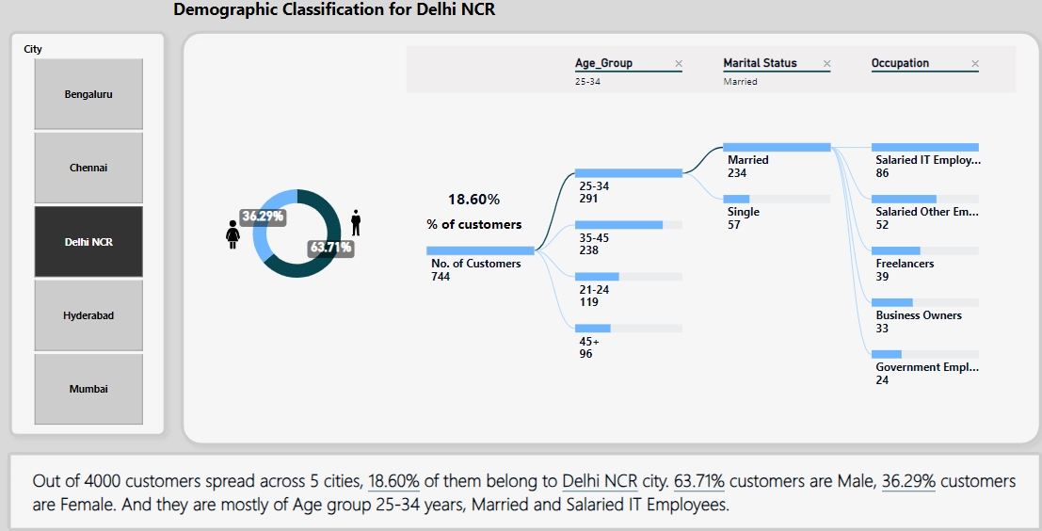
Demographics..

Slide 7
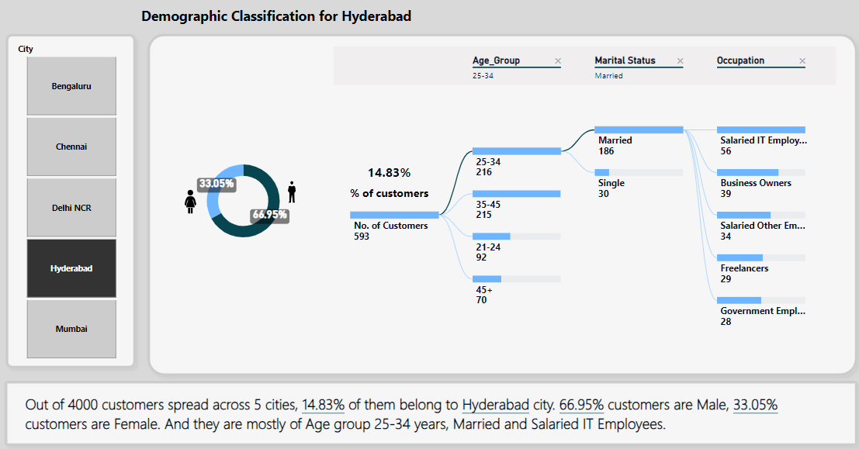
Demographics..

Slide 8
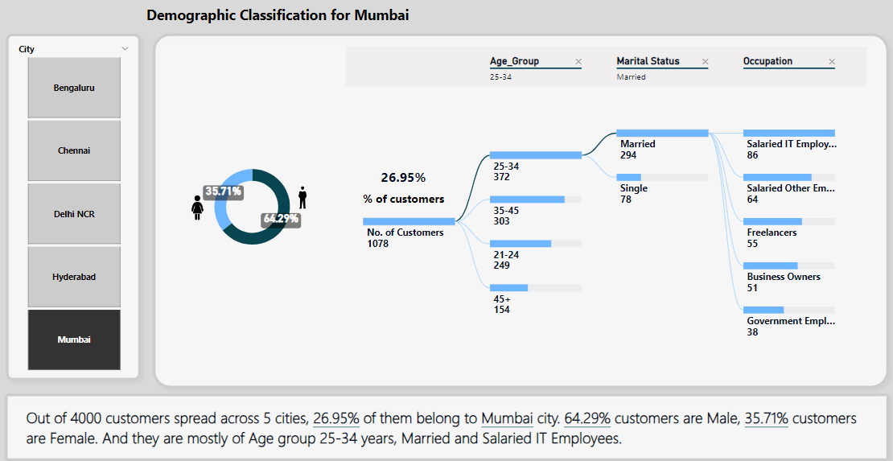
Demographics..

Slide 9

Spending Behaviour

Slide 10
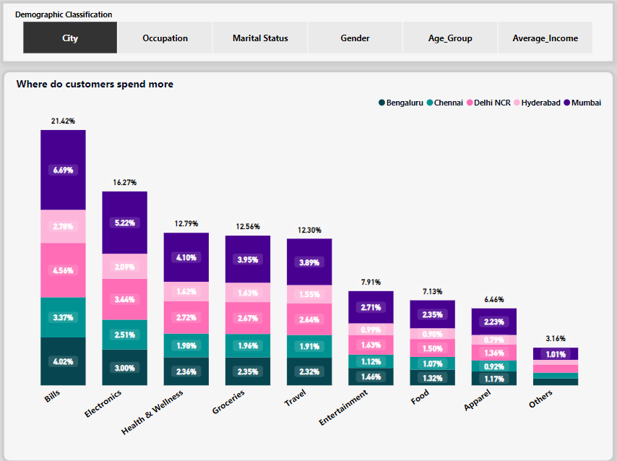
Overall customers spend 21.42% of the Total Amount for Bills(Utilities) and 16.27% for Electronics category. Mumbai customers are highest spenders in any category. They contribute 6.69% in Bills and 5.22% in Electronics categories.

Slide 11
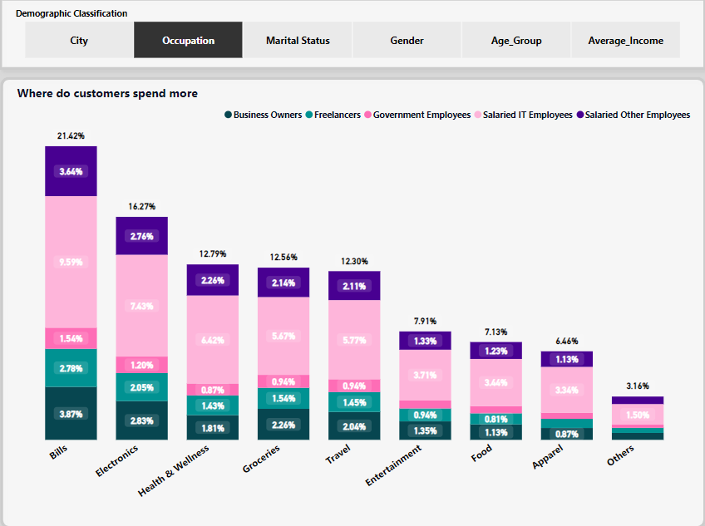
Salaried IT Employees are highest spenders in any category. However, they spend 9.59% in Bills and 7.43% in Electronics categories.

Slide 12
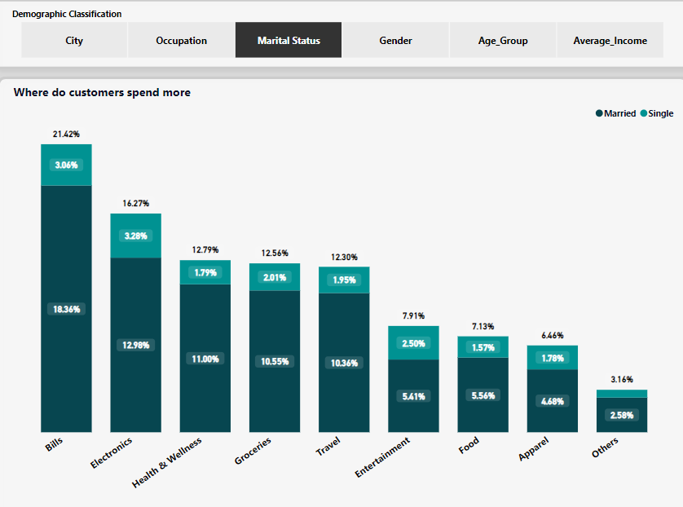
Married customers are spending more in any category as compared to customers who are Single. However, their topmost spending category is in Bills (18.36%) and then comes Electronics categories (12.98%).

Slide 13
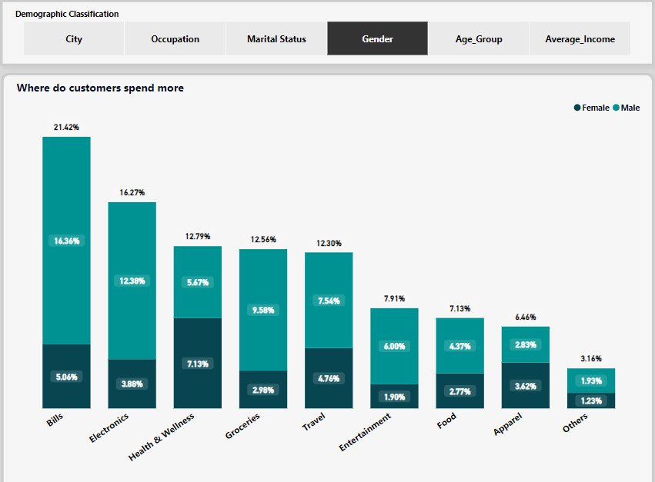
Male customers are spending more as compared to Female customers in any category. Their contribution is 16.36% in Bills and 12.38% in Electronics categories.

Slide 14
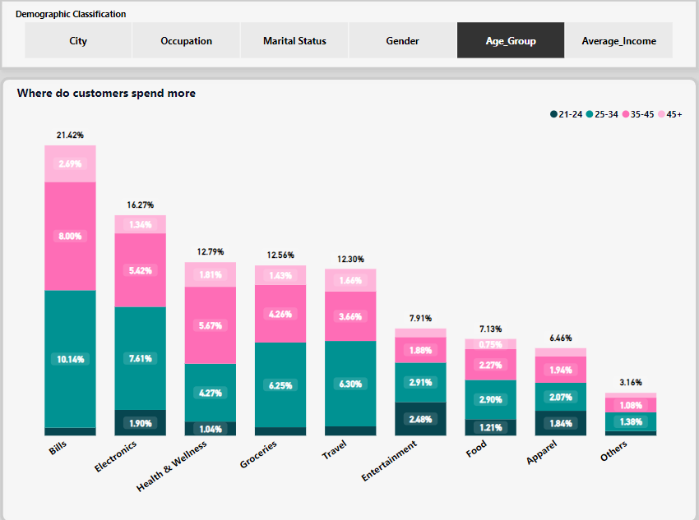
Customers of age group 25-34 years are highest spenders for any category. Their top 2 spending categories are Bills (10.14%) and Electronics(7.61%). Older people spend more on Bills(2.69%) as compared to Electronics(1.34%)

Slide 15
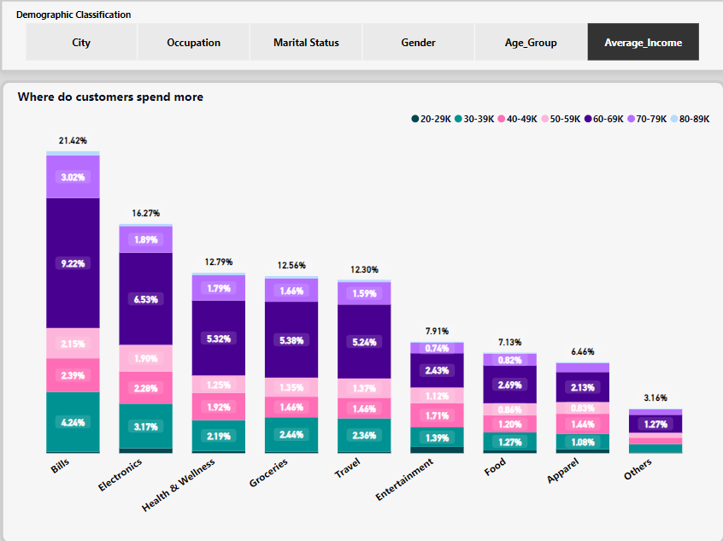
Customers earning 60K – 69K monthly average income are highest spenders in any category. Their top 2 spending categories are Bills (9.22%) and Electronics (6.53%).

Slide 16
Spending Behaviour - Monthly Statistics

Slide 17
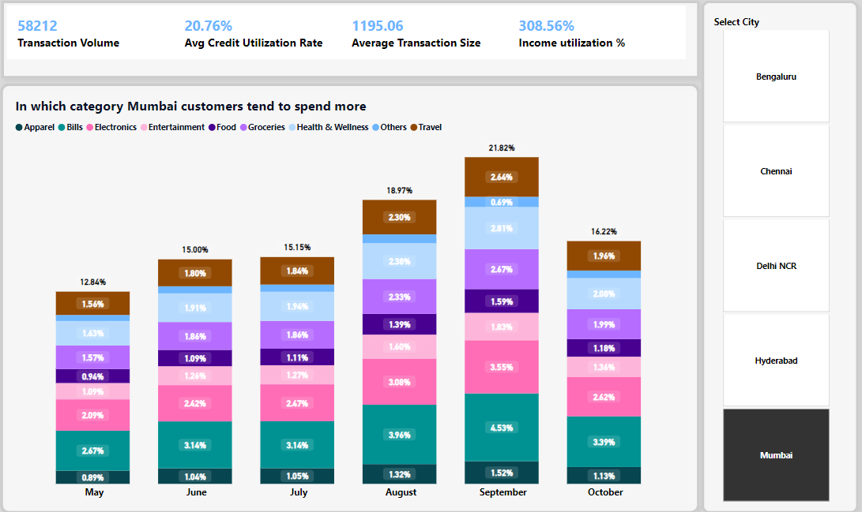
The top 2 highest spending categories are Bills and Electronics for any month. However, these 2 categories are seeing more contribution during September month, festive season - 4.53% in Bills(Utilities) and 3.55% in Electronics. Above chart shows Mumbai data. Please check the live PowerBI dashboard for other cities’ data.

Slide 18
Insights about Spending Behavior:
Bills(21.42%) and Electronics(16.27%) are the top 2 categories, where customers tend to spend more using their credit cards.
Demographic classification tells us that Mumbai customers, Married, Male, customers of age group 25-34 years and those who earn 60K – 69K INR per month use credit cards more for these 2 categories.
September month sees more spending as compared to other months with credit cards. Also, Bills and Electronics categories sees more spending for any month - 4.53% in Bills(Utilities) and 3.55% in Electronics for September month.
It is advisable to provide cashback/bonus rewards to the highest spenders specifically for bills (utility) and electronics purchases. Offers such as 2% cashback on all offline spends, 3% cashback on all online spends, and 5% cashback on Amazon. This would encourage more credit card usage and good savings on their pockets.

Slide 19

Key Performance Indicators (KPI)

Slide 20
Transaction Volume
Transaction Volume KPI measures the total number of credit card transactions processed within a given period.

Slide 21
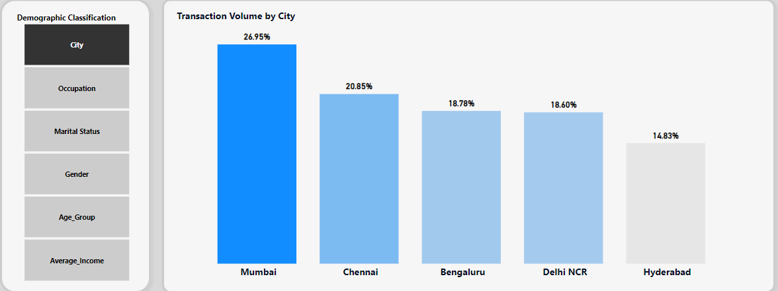
Mumbai customers transact 26.95% (highest) whereas Hyderabad customers transact 14.83% (lowest) of the Transaction Volume with their credit cards.

Slide 22
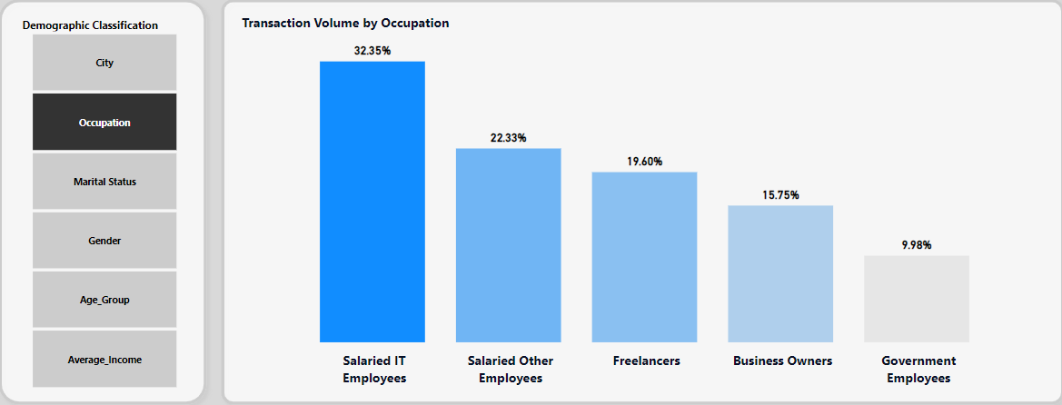
Salaried IT Employees transact 32.35% (highest) whereas Government Employees transact 9.98% (lowest) of transaction volume with their credit cards.

Slide 23
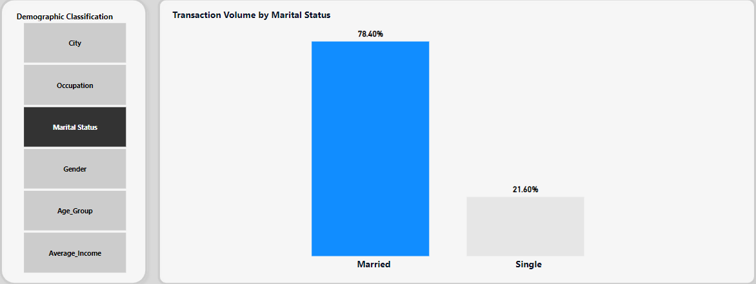
Married customers transact 78.40% and Singles transact 21.60% of the Transaction Volume with their credit cards.

Slide 24
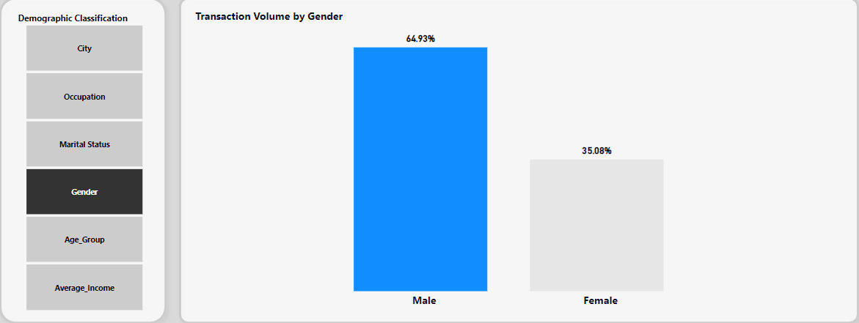
Male customers transact 64.93% and Females transact 35.08% of the Transaction Volume with their credit cards.

Slide 25
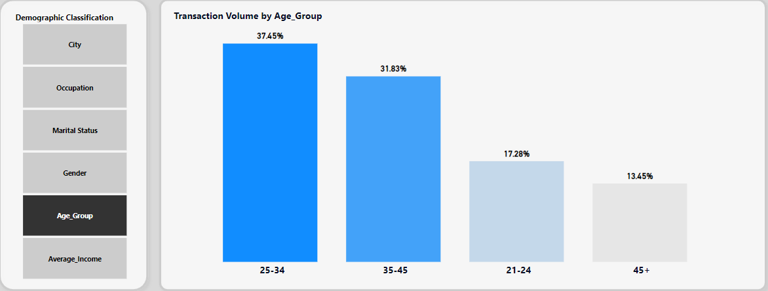
25-34 years age customers transact 78.40% whereas 45+ years age transact 13.45% of the Transaction Volume with their credit cards.

Slide 26
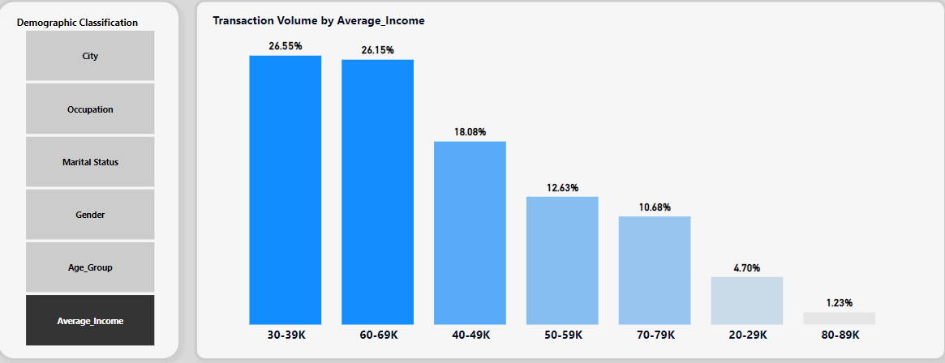
30K-39K average salary customers transact 78.40% whereas 80K-89K average salary transact 13.45% of the Transaction Volume with their credit cards.

Slide 27
Transaction Volume - Monthly Statistics

Slide 28
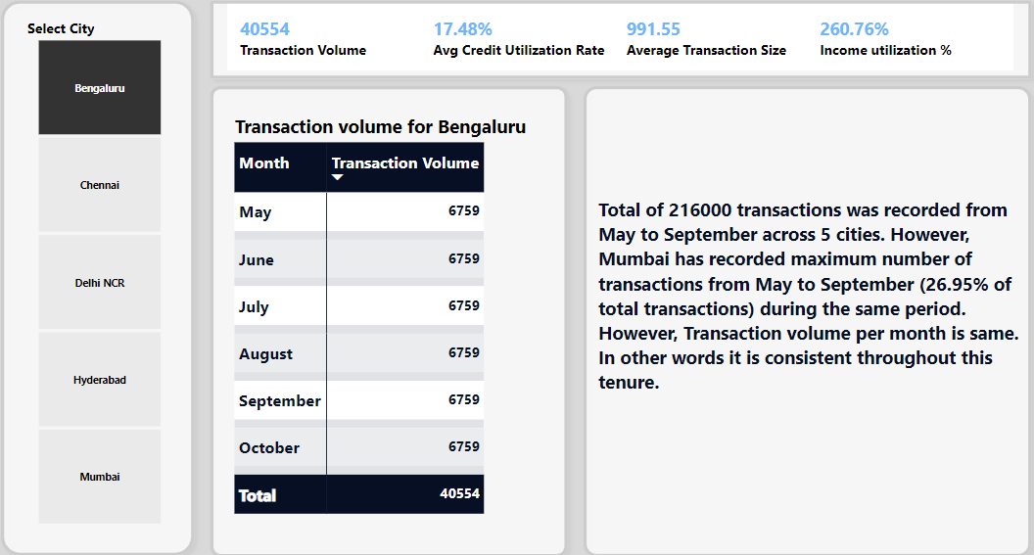
Above chart shows Bengaluru data. Please check the live PowerBI dashboard for other cities’ data.

Slide 29
Insights about Transaction Volume
No. of transactions per month is consistent for all 6 months across all 5 cities.
Mumbai customers contribute to 26.95% of total transaction volume. So also Salaried IT Employees, Married, Male, Age group 25-34 years and 30K-39K Average Salary customers contribute more to the total transaction volume. Hence cashback and rewards can be offered to encourage customers to use credit cards more for their online shopping.
This KPI provides insight into the overall business activity of the company and helps assess its operational efficiency.
Tracking this KPI would help credit card company to monitor their growth and identify patterns in customer behavior.
Also, a benchmark can be set and aimed to achieve year-over-year growth in transaction volume to stay competitive in the market.

Slide 30
Credit Utilization Ratio
Credit Utilization Ratio(CUR) = (Outstanding Balance per month/Available credit) %.
Outstanding balance, also called current balance that a customer owes to the credit card company at the end of specified time period.
Available Credit = Maximum amount that a customer is allowed to spend on his/her credit card. This amount is decided by the credit card company based upon factors like customer's creditworthiness, income level etc.
Credit Utilization ratio is the percentage of available credit that a customer is using on his/her credit card.
Based upon our input data, Outstanding balance = Amount spent per month by a customer.
Average Income have been clubbed into groups like 20K to 29999, 30K to 39999, 40K to 49999 and so on. Credit limit = mean of lower and upper limit of each group. 20K to 29999 Average Income = 24999.5 Credit limit.

Slide 31
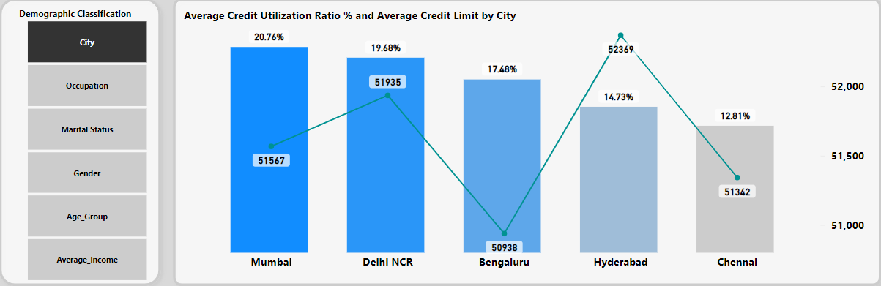
Average Credit Utilization Ratio is highest (20.76%) for Mumbai and lowest (12.81%) for Chennai. In other words, Mumbai utilize their credit limit more and also struggle more to meet his/her financial obligations as compared to Chennai customers.

Slide 32
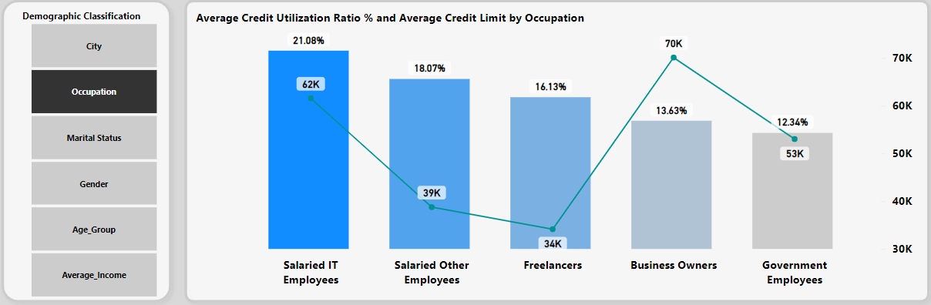
Average Credit Utilization Ratio is highest (21.08%) for Salaried IT Employees and lowest (12.34%) for Government Employees. In other words, Salaried IT Employees utilize their credit limit more and also struggle more to meet his/her financial obligations as compared to Government employees.

Slide 33
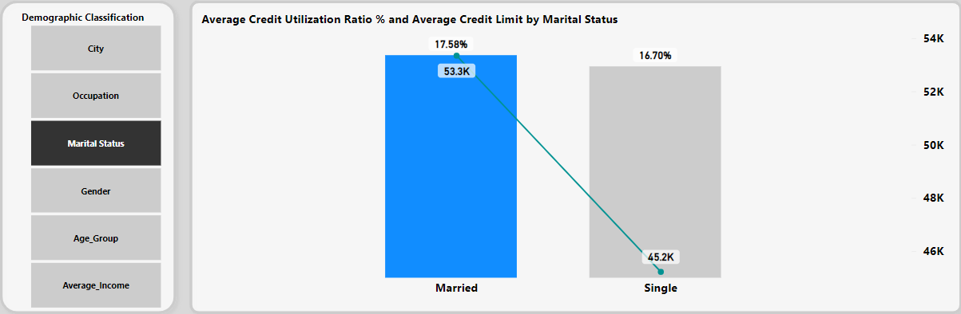
Average Credit Utilization Ratio is 17.58% for Married customers and 16.70% for Singles. In other words, Married utilize their credit limit more and also struggle more to meet his/her financial obligations as compared to Singles.

Slide 34
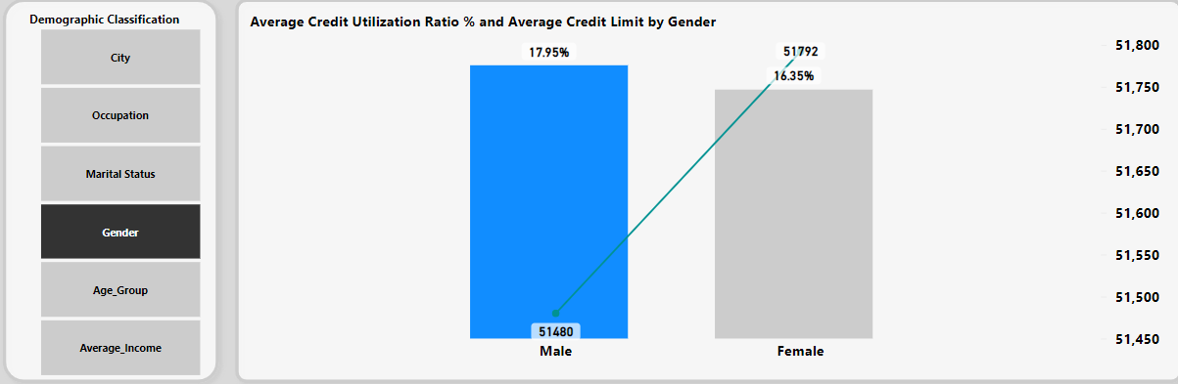
Average Credit Utilization Ratio is 17.95% for Male customers and 16.35% for Females. In other words, Male utilize their credit limit more and also struggle more to meet his financial obligations as compared to Females.

Slide 35
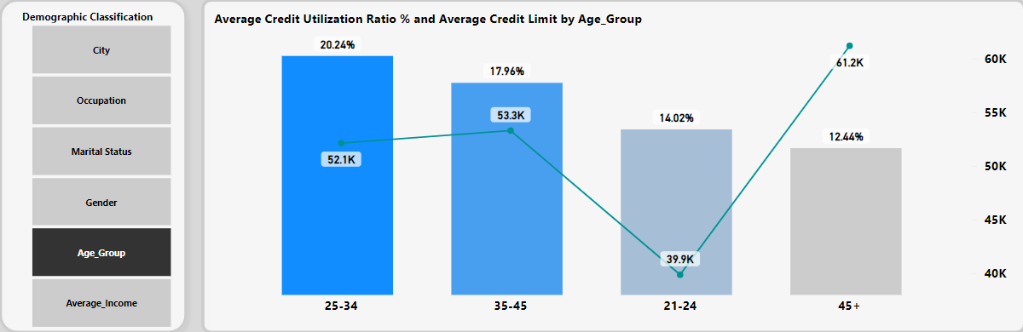
Average Credit Utilization Ratio is 20.24% for 25-34 years customers and 12.44% for 45+ years. In other words, younger customers utilize their credit limit more and also struggle more to meet his/her financial obligations as compared to older customers.

Slide 36
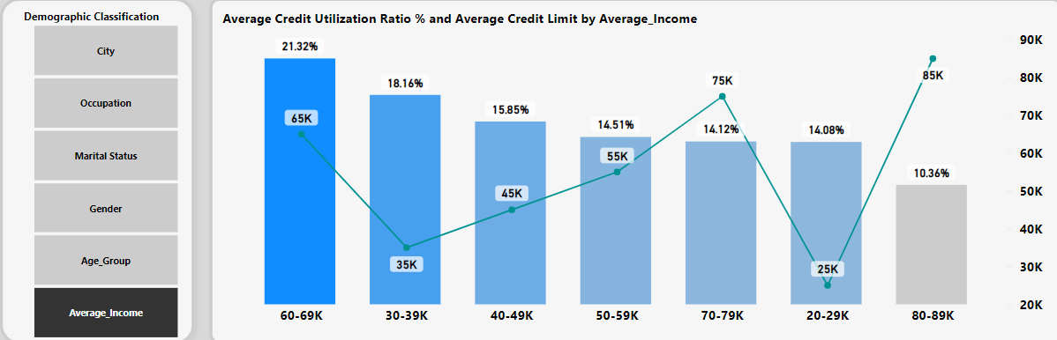
Average Credit Utilization Ratio is 21.32% for 60K-69K average salaried customers and 10.36% for 80K-89K average salaried customers. In other words, lower earning customers utilize their credit limit more and also struggle more to meet his/her financial obligations as compared to high earning customers.

Slide 37
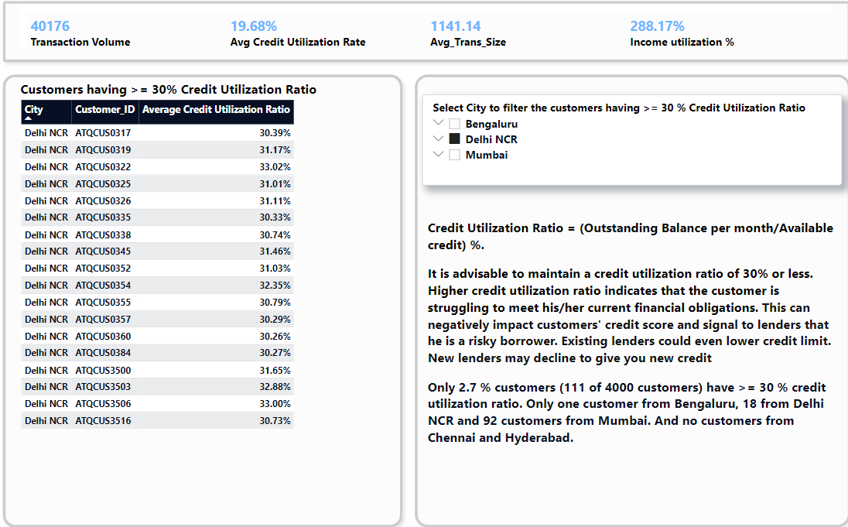

Slide 38
Insights about Credit Utilization Ratio
It is advisable to maintain a credit utilization ratio of 30% or less. Higher credit utilization ratio indicates that the customer is struggling to meet his/her current financial obligations. This can negatively impact customers' credit score and signal to lenders that he/she is a risky borrower. Existing lenders could even lower credit limit. New lenders may decline to give you new credit.
We see that only 2.7 % customers maintain credit utilization ratio of more than 30%. They are from Bengaluru, Delhi NCR and Mumbai. And no customers from Chennai and Hyderabad. Hence Chennai and Hyderabad customers should be focused on providing new credit cards.
Demographic classified customers maintaining high credit utilization ratio like Mumbai customers, Salaried IT Employees, Married, Male, 25-34 years age group, 30K-39K average salary customers utilize their credit limit to the maximum as compared to those maintaining low credit utilization ratio.

Slide 39
Average Transaction Size
Average Transaction Size = Total Amount Spent in a month / No. of transactions during same period.

Slide 40
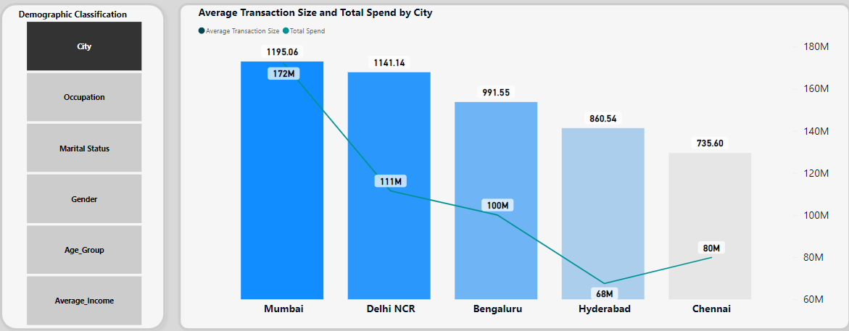
Mumbai city spends more and so its Average Transaction Size is maximum(1195.06) among 5 cities.

Slide 41
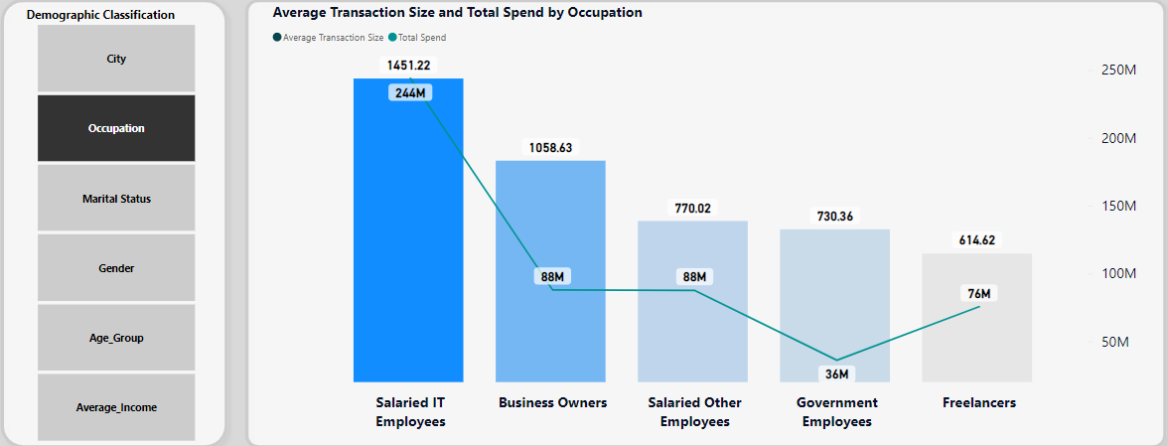
Salaried IT Employees spend more and hence their Average Transaction Size is maximum(1451.22) among 5 occupations.

Slide 42
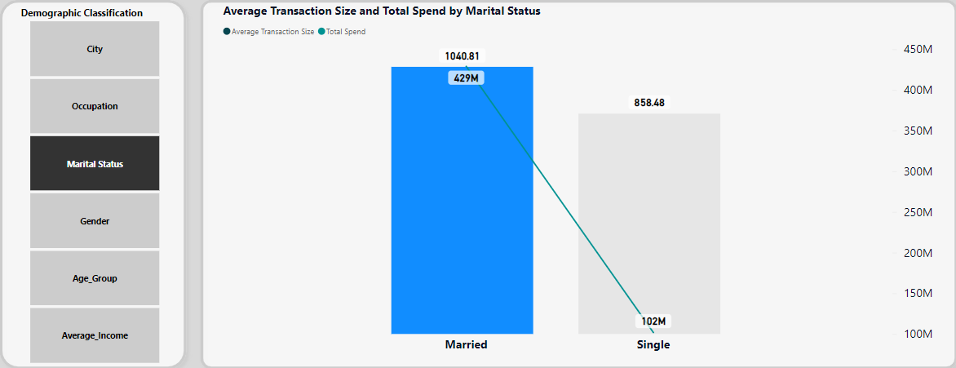
Married customers spend more and hence their Average Transaction Size is higher(1040.81) as compared to Singles.

Slide 43
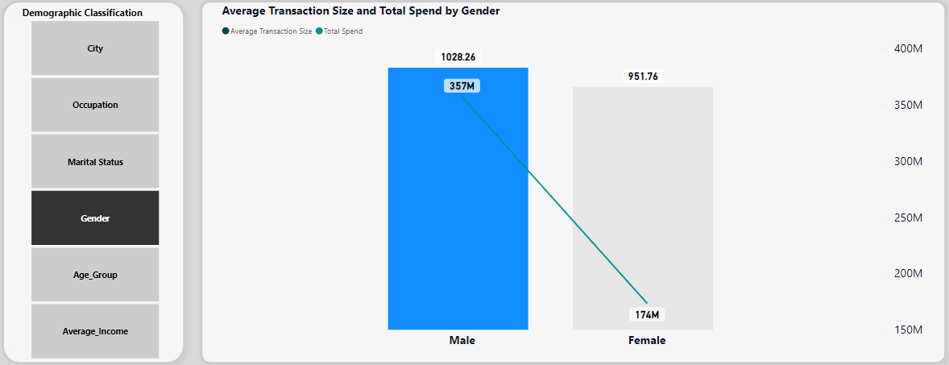
Male customers spend more and hence their Average Transaction Size is higher(1028.26) compared to Females.

Slide 44
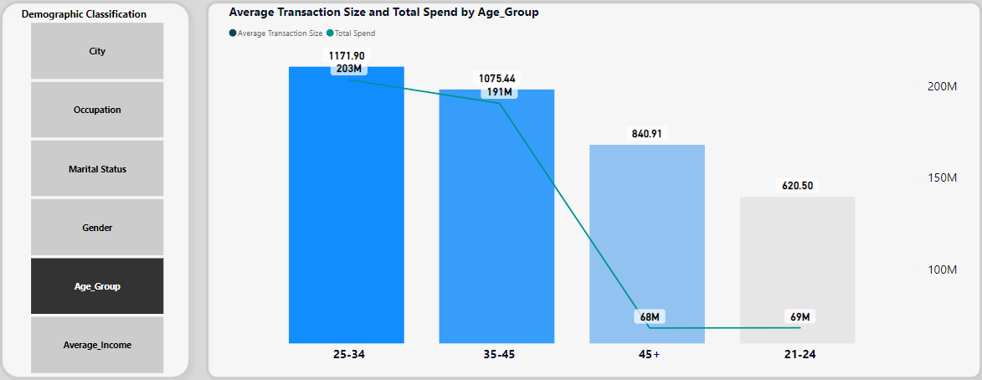
25-34 years age group customers spend more and hence their Average Transaction Size is higher(1171.90) compared to other age groups.

Slide 45
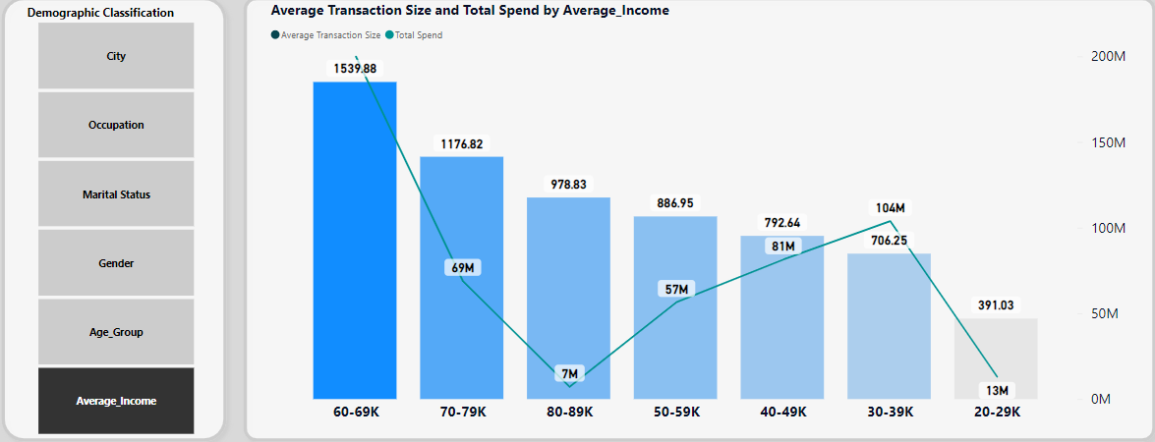
Customers having 60K-69K average salary spend more and hence their Average Transaction Size is higher(1539.88) compared to other customers.

Slide 46
Average Transaction Size - Monthly Statistics

Slide 47
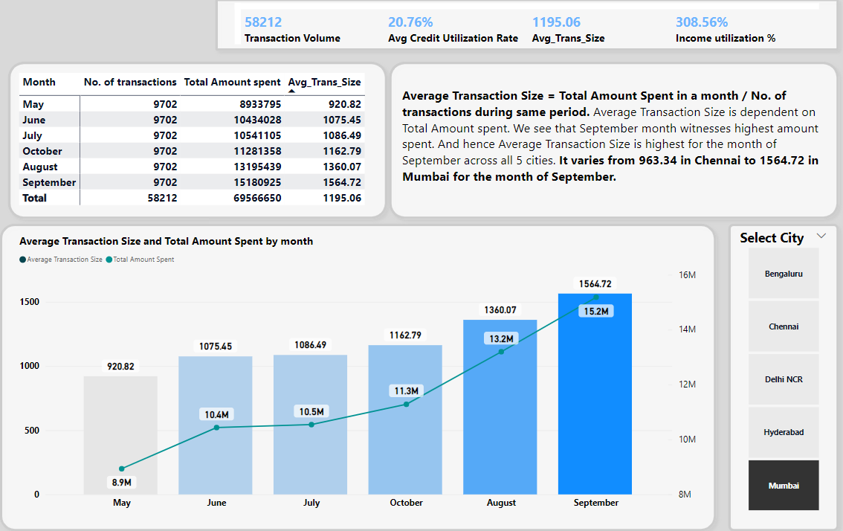
Average Transaction Size is dependent on amount spent. September month witnesses highest amount spent. And so Average Transaction Size is maximum in month of September (1564.72) for Mumbai. Please check other cities’ data in Live Power BI dashboard.

Slide 48
Insights about Average Transaction Size
Higher Average transaction size would mean customers are spending more per transaction on their credit cards. And lower Average transaction size would mean customers are spending less per transaction on their credit cards. Which is a good indication.
Average transaction size is more in the month of September due to festive season.
Offers like cashback on online/offline purchases, special discount, rewards should be provided to encourage customers to use their credit cards more.
Hence focus should be turned onto customers with higher average transaction size.

Slide 49
Income Utilization
Income Utilization = (Spend/Average Income) %

Slide 50
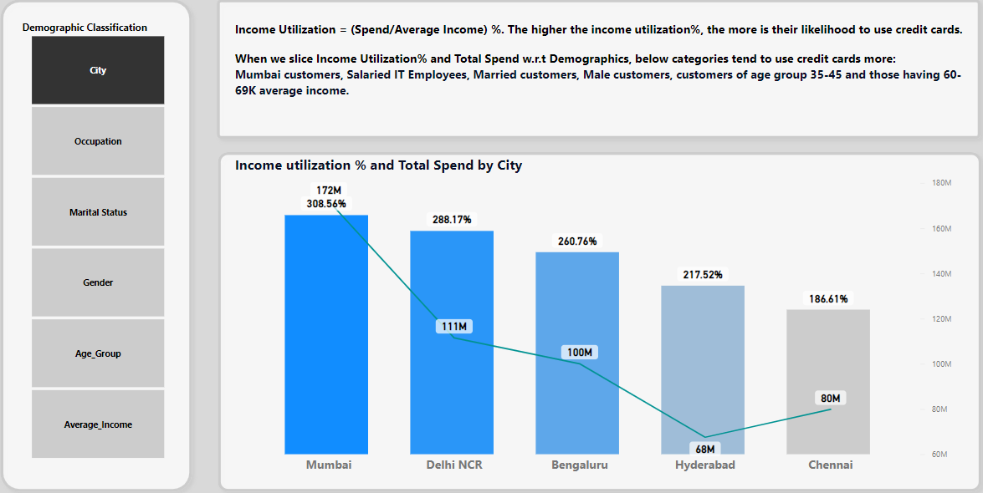
Mumbai customers spend more and hence their Income Utilization is higher(308.56%) compared to other cities. And Chennai has the lowest Income Utilization.

Slide 51
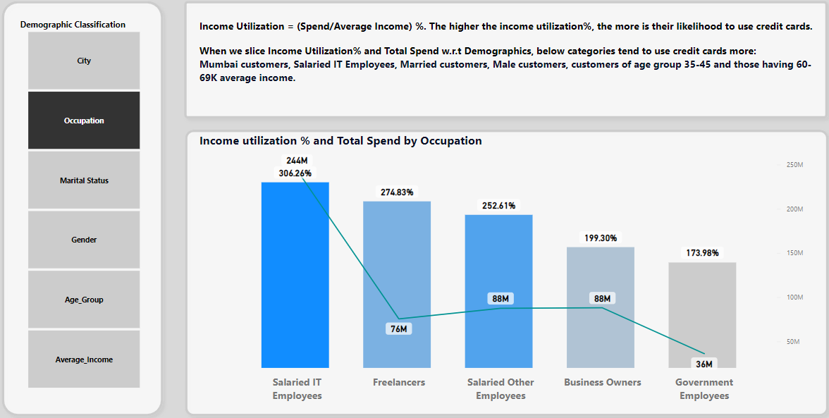
Salaried IT Employees spend more and hence their Income Utilization is higher(306.26%) compared to other occupation. And Government employees has the lowest Income Utilization.

Slide 52
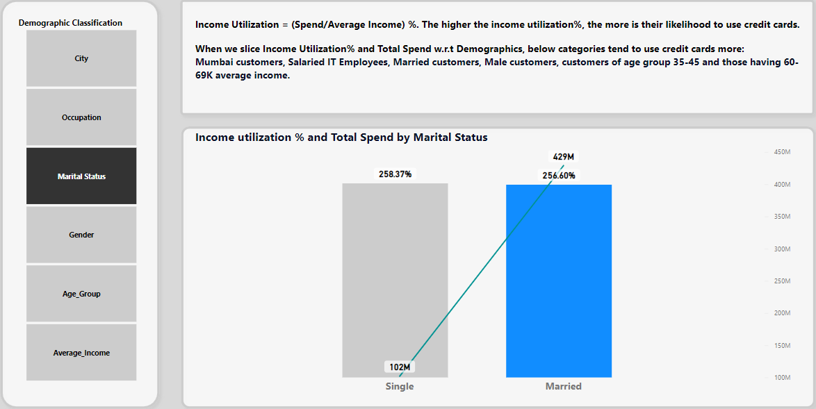
Singles spend more than Married customers and hence their Income Utilization is 258.37%, more compared to Married customers.

Slide 53
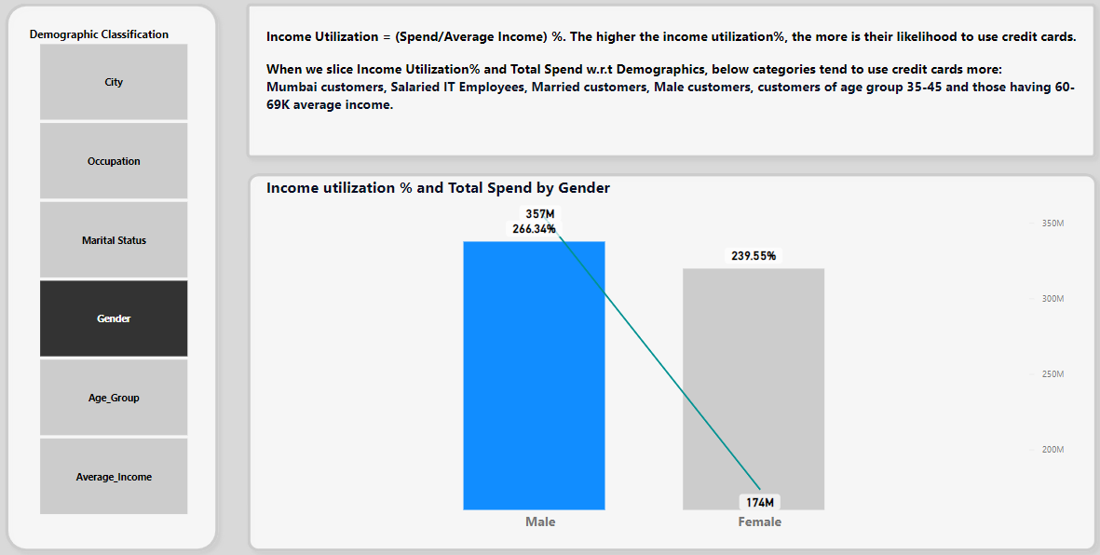
Male customers spend more and hence their Income Utilization is higher(266.34%) compared to Female customers.

Slide 54
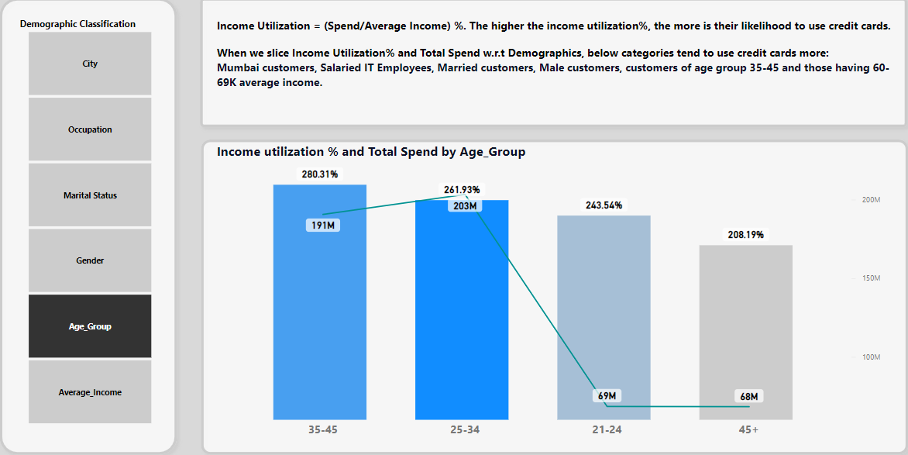
25-34 years and 35-45 years age group customers spend more and hence their Income Utilization is higher(280.31%) and (261.93%). And 45+ years has the lowest Income Utilization.

Slide 55
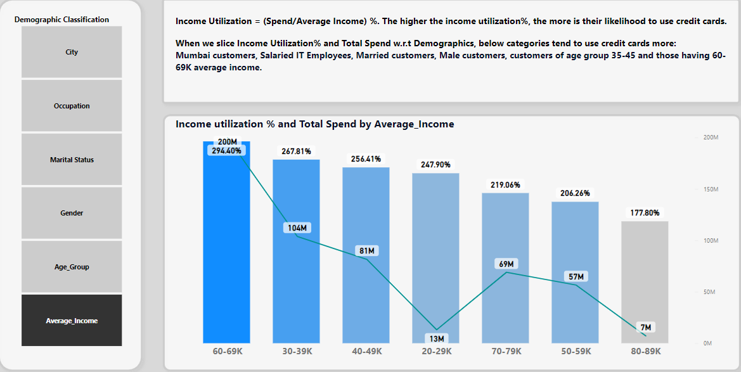
Customers with 60K-69K average salary spend more and hence their Income Utilization is higher(294.40%) compared to other customers. And those with 60K-69K average salary has the lowest Income Utilization.

Slide 56
Income Utilization - Monthly Statistics

Slide 57
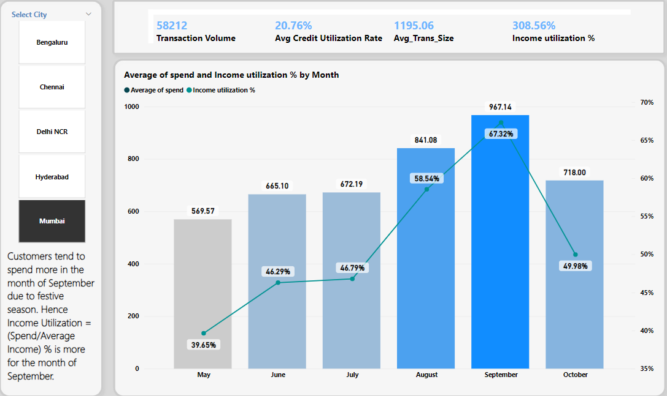
September month witnesses highest spending due to festive season. Hence Income Utilization(967.14%). is highest in the month of September. Above chart shows Mumbai data. Please refer to Live PowerBI dashboard for other cities’ data.

Slide 58
Insights about Income Utilization
Income Utilization = (Spend/Average Income) %. Higher the income utilization, customers are more likely to use credit cards for their expenses.
During September month, people spend more using credit cards due to festivity. Hence income utilization for Sep month is higher. So, special rewards and cashback on online/offline purchases should be offered during this time to encourage customers to use their credit cards more and save their pockets.
Demographic analysis reveals that Mumbai customers, Salaried IT Employees, Married, Male, younger people (age group 25-34) and those having higher salary (60K-69K) have higher income utilization as compared to their counterparts. Hence focus should be turned onto these customers.

Slide 59
Insights and Recommendations
Customers tend to spend more on Bills and Electronics using their credit cards. Offers such as 2% cashback on all offline spends, 3% cashback on all online spends, and 5% cashback on Amazon. This would encourage more credit card usage and good savings on their pockets.
Based upon our analysis, we can infer that Mumbai customers, Salaried IT Employees, Married, Male, younger age group 25-34, and those having average salary 60K – 69K use more credit cards compared to their counterparts.
All 4 KPI’s – Transaction Volume, Average Credit Utilization Ratio, Income Utilization and Average Transaction are higher during September month. Special rewards like discounts and cashback during festive season encourages customers to use credit cards for their shopping and saves their pockets.
A good worthy customer would be the one who maintains CUR < 30. Based upon our analysis, Chennai and Hyderabad customers maintain CUR < 30. Also Government Employees maintain a low CUR. So these customers should be focused upon for the new credit cards.
Also, older people (45+ years) spend more on Bills(Utilities) as compared to Electronics. So older people should be given cashback on Bills rather than Electronics. Whereas younger people tend to spend more on Electronics, so younger people should be given cashback on Electronics rather than Bills.

Slide 60
Customer retention rate(CRR) measures the percentage of customers who continue to use a product or service within a defined period.
CRR = (Ending Customers – New Customers)/Beginning Customers * 100
Based upon our data, No. of customers from May start until September end have remained the same i.e. 4000. Also no new customers have been added during this time. Hence
CRR = (4000 – 0)/4000 * 100 = 100
It is an important metric that influences a company's growth and profitability. A high retention rate indicates that customers are sticking with the product.
Net Promoter Score (NPS) is a customer satisfaction metric that measures how likely customers are to recommend a company’s products or services to others.
NPS=% promoters−% detractors
% promoters is the percentage of customers who are promoters.
% detractors is the percentage of customers who are detractors
To calculate NPS, first ask your customer base the standard NPS question: “How likely are you to recommend us on a scale from 0 to 10?” If 80% of respondents are promoters and 10% are detractors, then you have an NPS of 70, which means we have good no. of promoters. Any score above 30 is good.
.

